Slide 1

Smart Energy Consumption Analysis and Prediction
using Machine Learning with Device-Level Insights.
-NEELAM MANASA

Slide 2
INTRODUCTION
This project focuses on smart energy consumption analysis and prediction using machine learning techniques with device-level insights. With increasing electricity demand, there is a need for intelligent systems that can analyze usage patterns and forecast future consumption.
By leveraging historical energy data, this project aims to provide accurate predictions and meaningful insights that support efficient energy utilization. The solution combines data analysis, deep learning, and interactive visualization to improve energy management.

Slide 3
PROBLEM STATEMENT
Traditional energy monitoring systems provide only overall electricity consumption data, making it difficult for users to identify which individual devices consume the most power. These systems lack detailed analysis of energy usage patterns across different time intervals such as hourly, daily, or monthly periods.
Additionally, there is no capability to predict future energy consumption, which limits proactive energy planning. The absence of intelligent insights and recommendations also prevents users from taking effective actions to reduce electricity costs and improve energy efficiency.

Slide 4
PROBLEM OBJECTIVES
The objective of this project is to apply machine learning techniques to study and forecast smart energy usage at the individual device level. By utilizing historical smart home energy data, the system aims to provide accurate predictions and meaningful insights that support efficient energy management and reduced power wastage.
Key Objectives
Examine and understand energy usage trends across different household devices
Develop reliable energy prediction models using LSTM-based deep learning techniques
Provide device-wise analytical insights to improve energy efficiency
Support near real-time energy consumption prediction for better decision-making

Slide 5
DATASET DESCRIPTION
Smart Home Energy Monitoring Dataset (Kaggle).
6 months of timestamped power readings.
Attributes: Timestamp, Device, Power Consumption.
Devices: AC, Light, TV, Fridge, etc.

Slide 6
SYSTEM ARCHITECTURE
Data Collection
Data Preprocessing
Feature Engineering
LSTM Model Development
Model Training & Evaluation
Streamlit Application
Interactive Dashboard & Predictions

Slide 7
Data Preprocessing & Feature Engineering Pipeline

Slide 8
Module 1: Data Collection & Exploration
In this module, the energy consumption dataset is loaded using Python libraries such as Pandas. Initial exploration is performed to understand device-wise energy usage patterns. Missing timestamps are identified, and basic visualizations are created to observe overall consumption trends.
Module 2: Data Cleaning & Preprocessing
This module focuses on cleaning the dataset by handling missing values and outliers. Timestamps are converted into datetime format for time-series analysis. The data is resampled into hourly and daily intervals, and energy values are normalized to improve model performance.

Slide 9
Module 3: Feature Engineering
In this stage, important time-based features such as hour, day, week, and month are extracted from the dataset. Lag features and moving averages are created to capture historical dependencies. The final output of this module is a structured, model-ready dataset.
Module 4: Baseline Model – Linear Regression
A Linear Regression model is developed as a baseline to predict future energy consumption. The model’s performance is evaluated using metrics such as MAE and RMSE. Actual and predicted values are compared to understand the limitations of traditional models.

Slide 10
Module 5: LSTM Model Development
This module involves designing and training an LSTM-based deep learning model using TensorFlow and Keras. The model learns time-dependent energy consumption patterns more effectively. Hyperparameters are tuned, and the LSTM model is compared with the Linear Regression model for accuracy.
Module 6: Model Evaluation & Streamlit Integration
The trained models are evaluated using RMSE, MAE, and R² score, and the best-performing LSTM model is selected. The trained model is saved and integrated directly into a Streamlit application to enable real-time energy consumption prediction.

Slide 11
Module 7: Streamlit Dashboard & Visualization
In the final module, an interactive dashboard is developed using Streamlit. The dashboard displays device-wise energy consumption, hourly, daily, and monthly usage patterns, and future energy predictions. It also provides simple energy-saving suggestions based on usage trends.

Slide 12
Smart Suggestions Engine
High usage detected. Consider reducing usage
Moderate usage. Try optimizing power usage.
Energy usage is optimal

Slide 13
RESULTS
LSTM achieved higher accuracy than Linear Regression.
Lower RMSE value.
Accurate future energy prediction.

Slide 14
ADVANTAGES
Reduces electricity bill.
Improves energy efficiency.
Easy to use dashboard.
Scalable and flexible system.

Slide 15
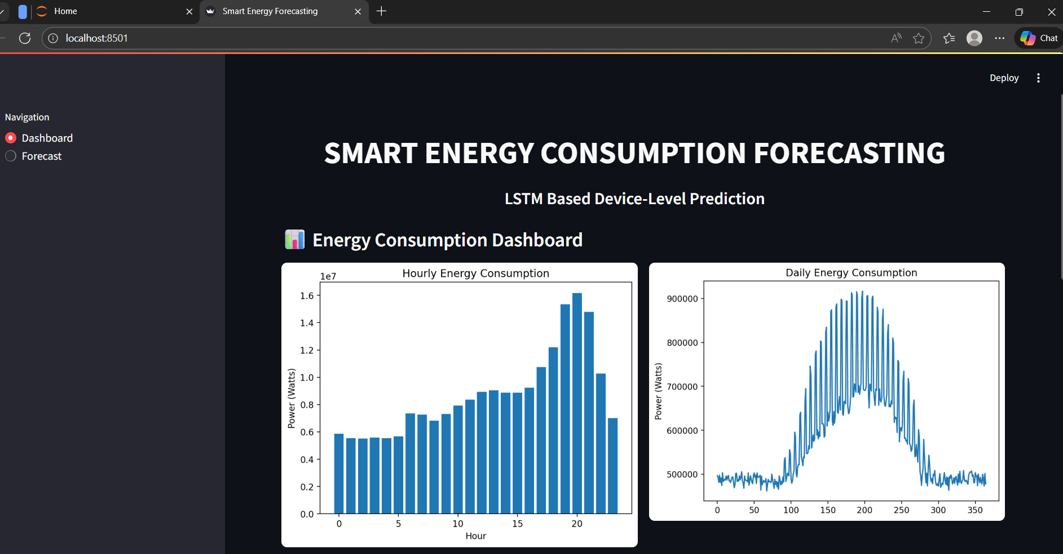

Slide 16
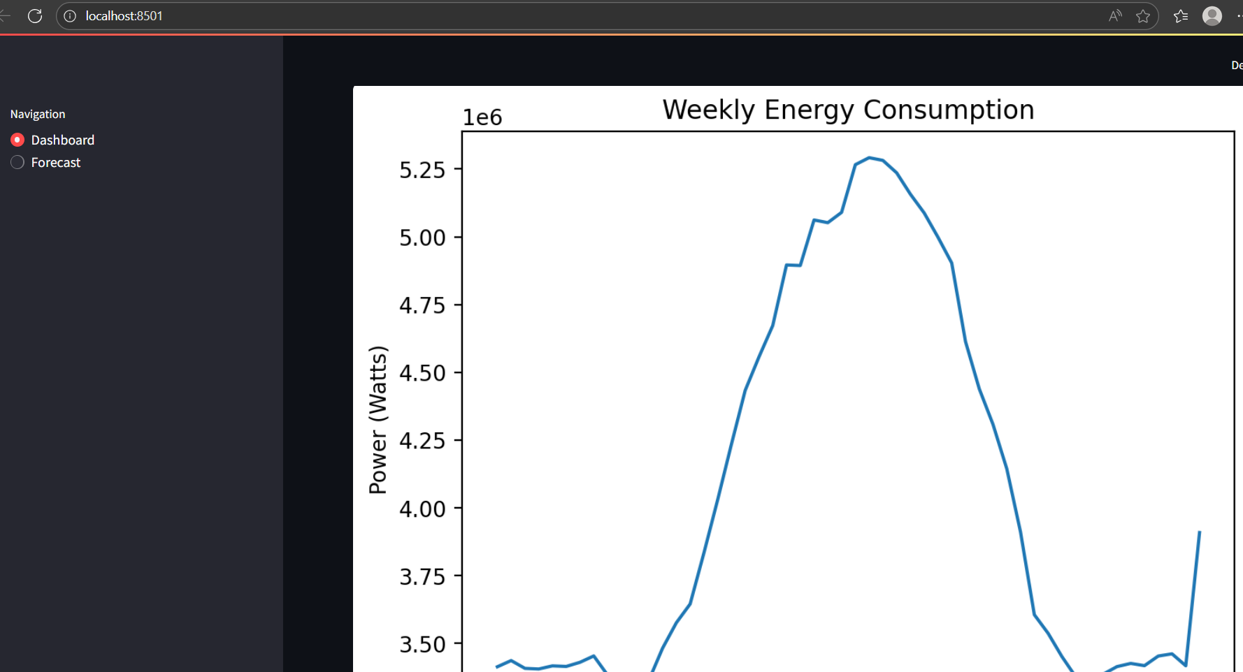

Slide 17
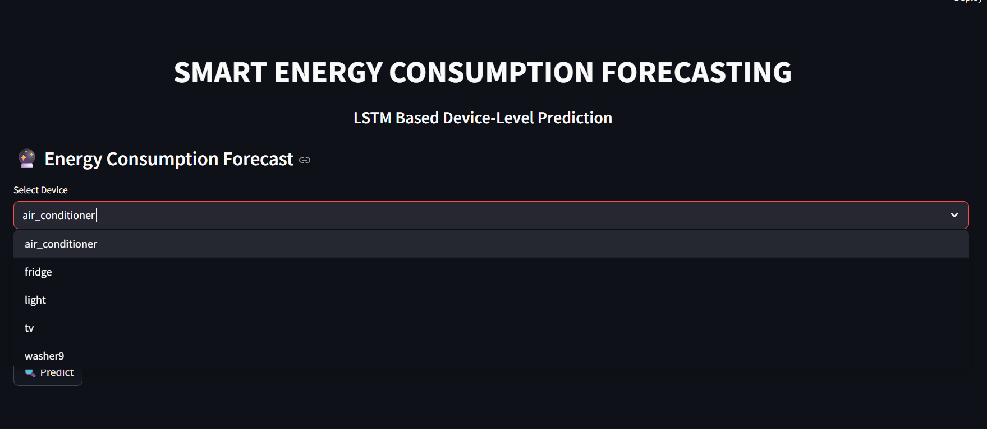

Slide 18
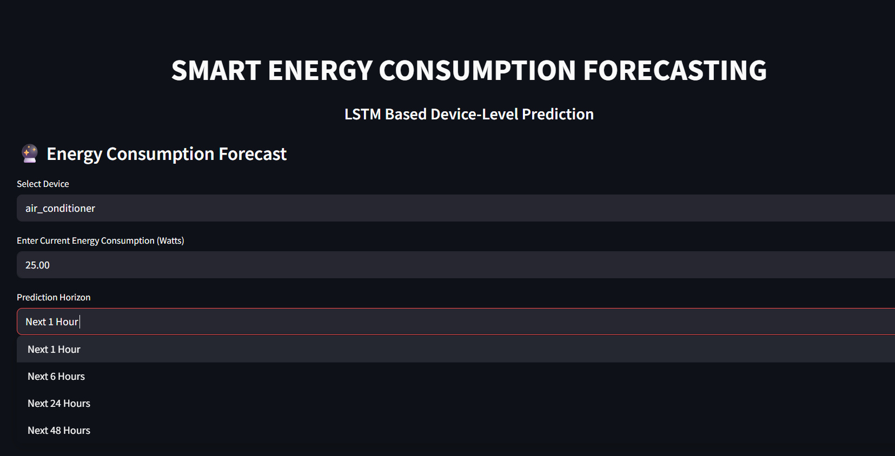

Slide 19
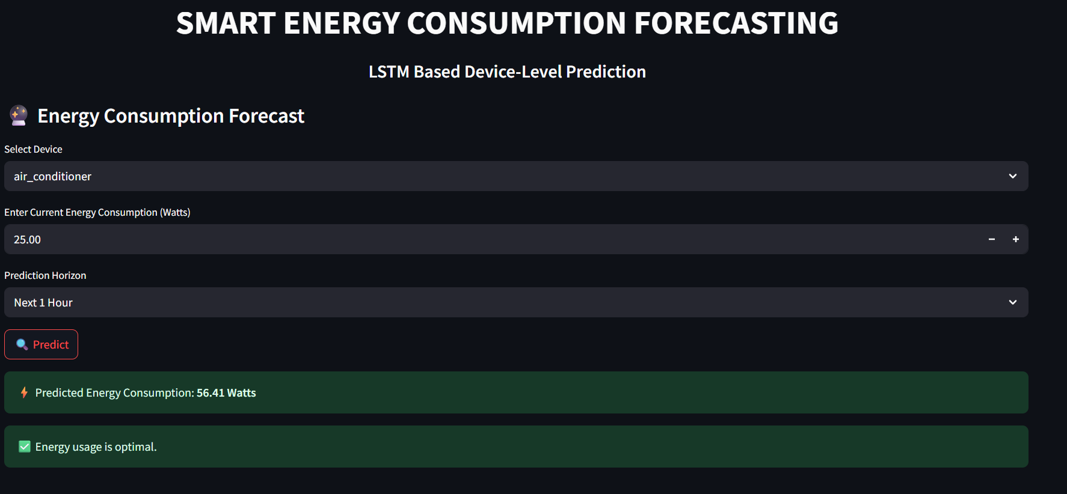

Slide 20
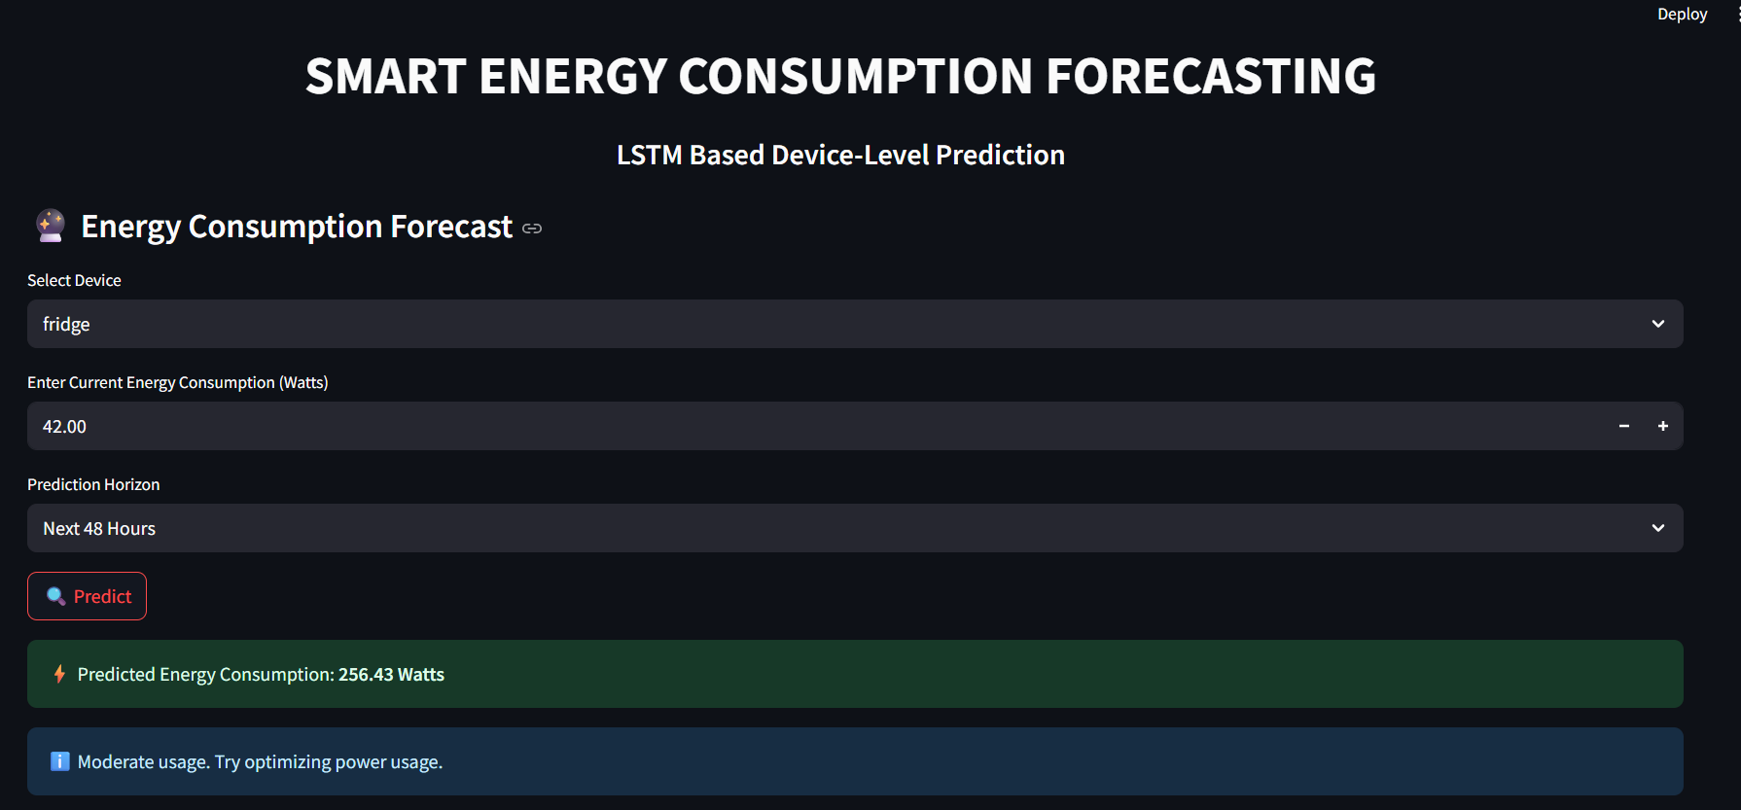

Slide 21
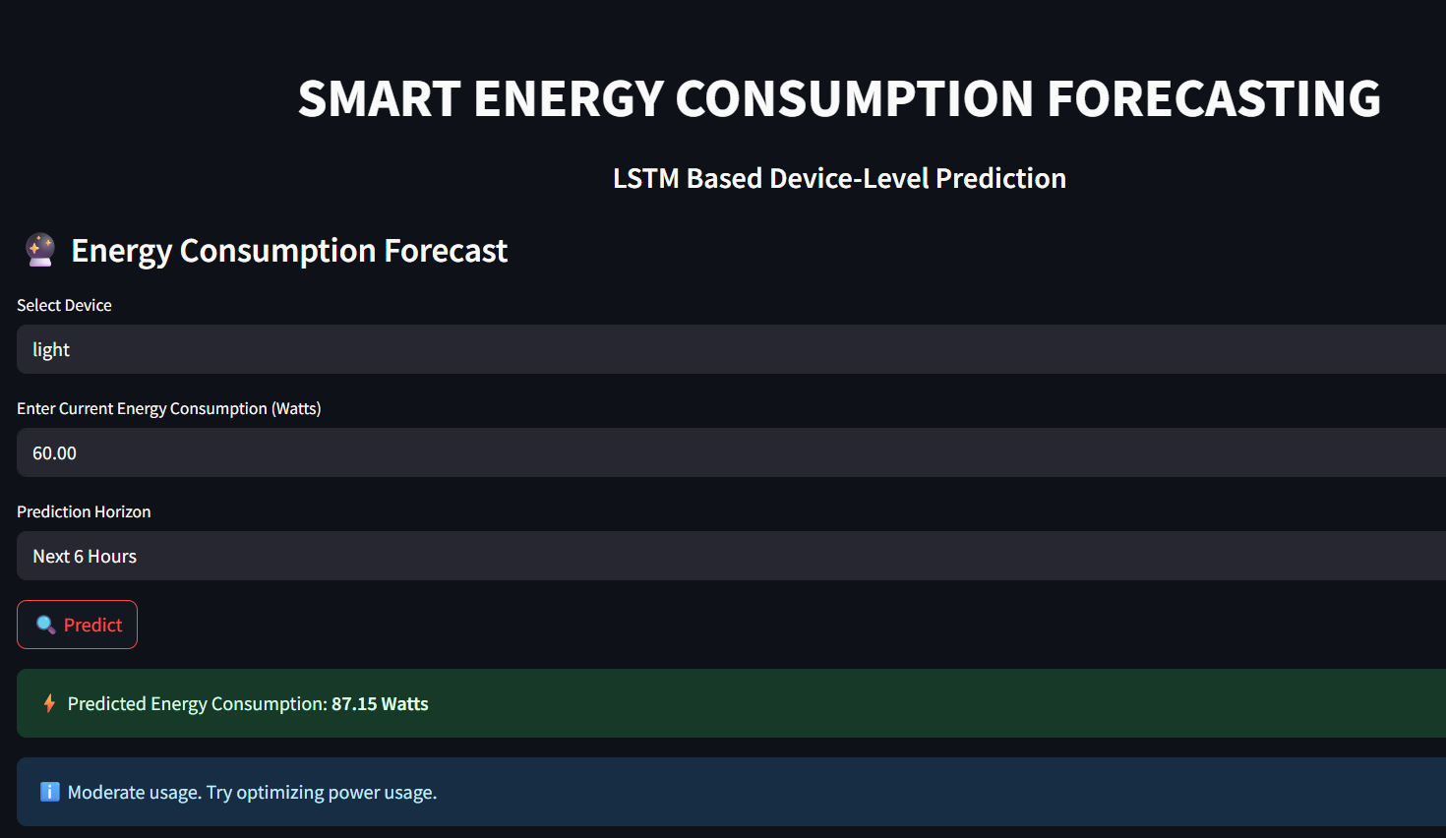

Slide 22
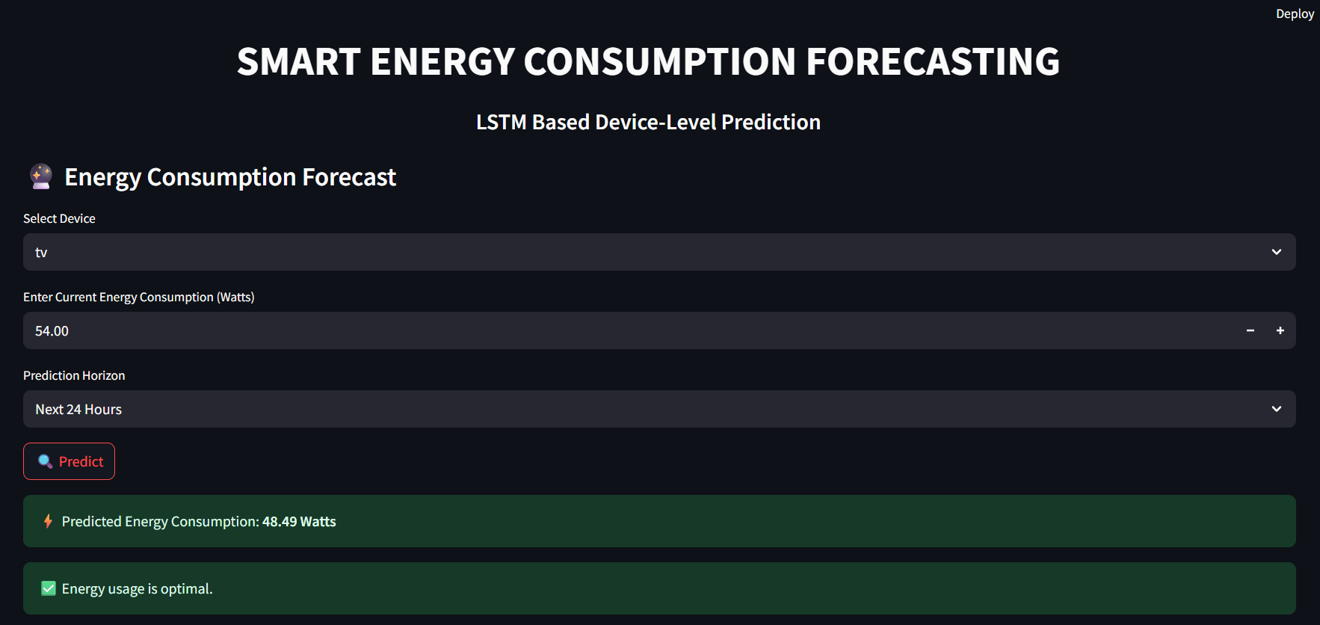

Slide 23
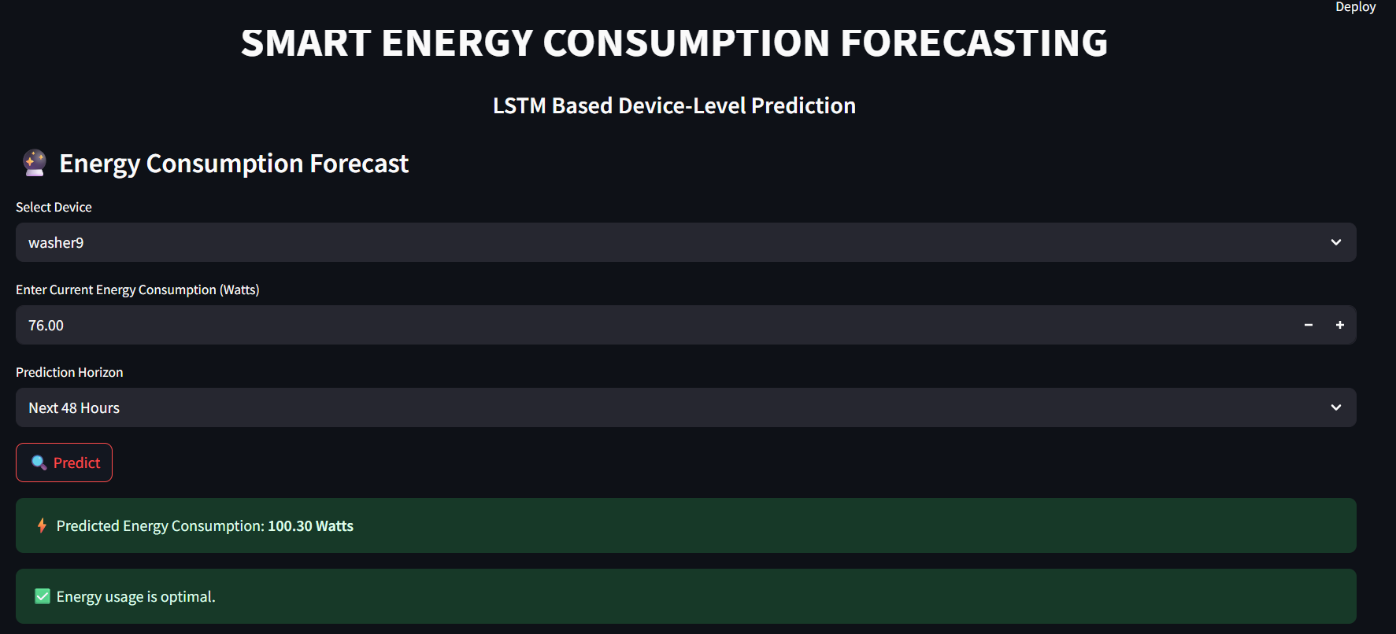

Slide 24
FUTURE SCOPE
IoT sensor integration.
Anomaly detection.
Smart home automation.
Cloud deployment.

Slide 25
CONCLUSION
Smart energy system improves sustainability.
Accurate prediction helps planning.
Supports energy efficient behavior.

Slide 26


Slide 27


